Slide 1
COMP90050:Advanced Database Systems
Professor Rao Kotagiri
SCIS
Lecture Set2

Slide 2
Fault Tolerance
P(A) = probability of an event A is happening in certain period.
P(A and B) = probability both events A and B happening in that period = P(A)*P(B) assuming A and B are independent events.
P(A or B) = P(A) + P(B) - P(A and B)
Assuming A and B are independent.
= P(A) + P(B) - P(A) * P(B)
= P(A) + P(B) if P(A) and P(B) are very small.
Mean time to event MT(A) = 1/P(A)

Slide 3
Fault Tolerance ...
If events A, B, have mean time MT(A), MT(B), then the mean time to the first event is
1/(P(A) + P(B) – P(A,B)), assuming P(A) and P(B) are very small we can assume P(A,B) ≅ 0.
= 1/(P(A) + P(B)).

Slide 4
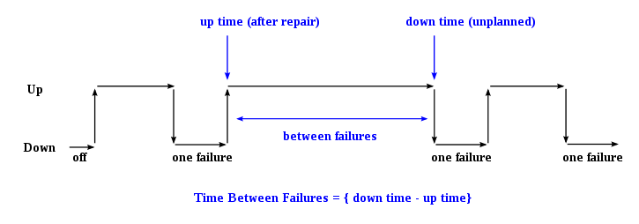
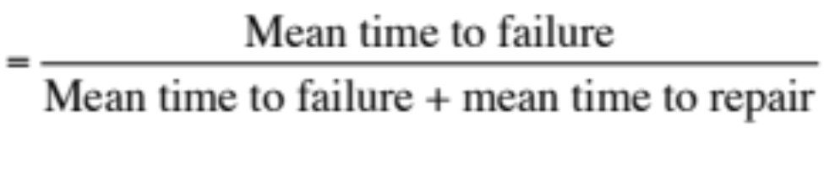
Fault Tolerance ...
Module availability : measures the ratio of service accomplishment to elapsed time.
Repair time

Slide 5
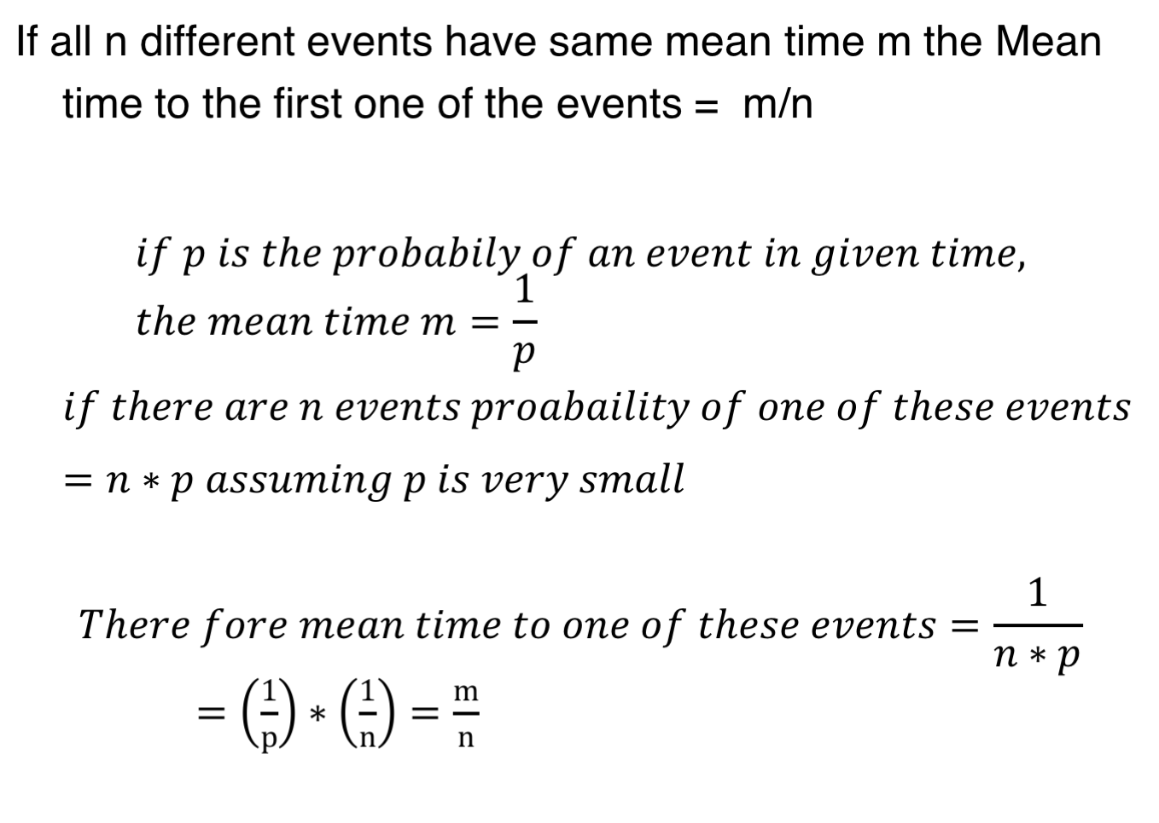
Fault Tolerance ...

Slide 6
Fault Tolerance ...
Sys Type | Unavailability minutes/year | Availability | Class
Unmanaged | 52 560 (~37 days) | 90% | 1
Managed | 5 256 (3.7 days) | 99% | 2
Well managed | 526 (~9 Hours) | 99.9% | 3
Fault tolerant | 53 (~1 hour) | 99.99% | 4
Ultra availability | 0.05 (3 Secs) | 99.99999% | 7

Slide 7
Fault Types
Environmental : failures such as cooling, power, weather, data communication lines, fires, earthquakes, tsunami, wars, sabotage
Operational: system administration, system configuration and system operation procedures
Maintenance: procedures for regular maintenance, replacement of hardware on regular basis
Hardware: devices, cooling
Software: programs
Process: strikes, management decisions for shutdowns
Civil Wars

Slide 8
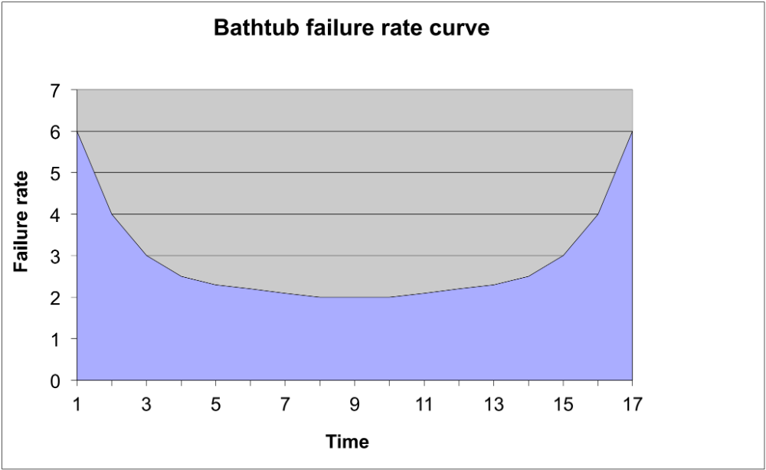
Failure Rates

Slide 9
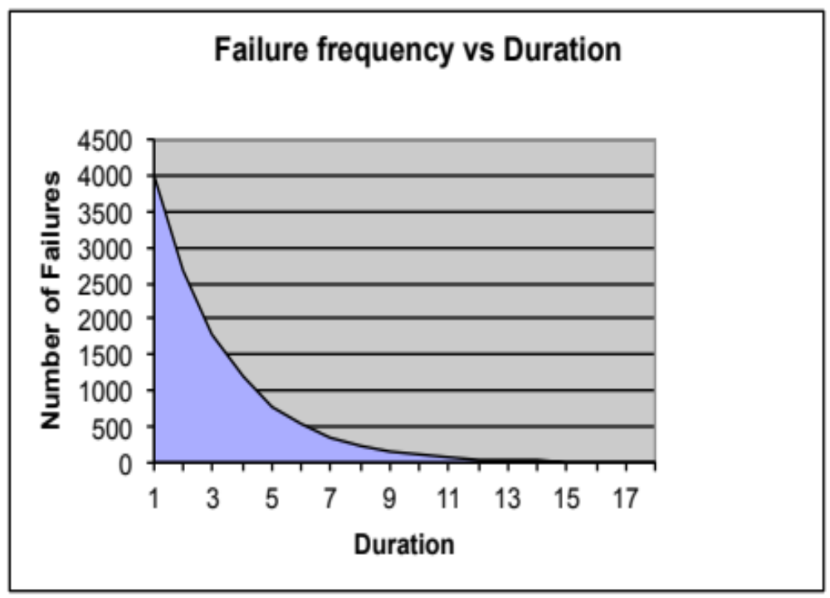
Failure Rates

Slide 10
Disk failure rates
Type of Error | MTTF | Recovery | Consequence
soft data | 1 h | Retry | none
seek | 6 h | Retry | none
Maskable hard data | 3 d | ECC (Error Correcting Coding) | remap
Unmaskable hard data | 1 y | none | remap
repair | 5 y | repair | data unavailable

Slide 11
Category of faults (Japanese Study 1985)
Category of Fault | Mean Time To Failure (MTTF)
Vendor (Hardware, Software, Maintenance) | 6 months
Application | 8 months
Telecommunication Lines | 2 years
Operations | 2 years
Environment | 2 years
Any of the above faults | 10 weeks

Slide 12
Fault Tolerance
Failvote - use two are more modules and compare their outputs. Stops if there are no majority outputs agreeing. It fails twice as often with duplication but gives clean failure semantics
  With triplication the system has MTTF of 5/ 6 of single module = 1/3+1/2 = 0.83 (Let M is MTTF of single module. MTTF any one the modules in triplicate system is M/3 and then MTTF one of two working modules is M/2. Giving overall MMTF of M*(1/3+1/2) = 0.83M)
Failfast (voting)- this scheme is similar to fail voting except the system senses which modules are available and then uses the majority of the available modules.
  A 10-plex module system continues to operate until the failure of 9 modules where as Failvote stops when 5 modules fail.
  Failfast voting system has better reliability than failvote voting (since it stops when there is no majority agreement).

Slide 13
Fault Tolerance ...
E.g. Consider a system with modules each with MTTF of 10 years including soft faults.
With a paired (Duplex) system with Failvote MTTF = 10/2 = 5 years.
With triplex system is 10/3 for the first failure + 10/2 for the 2nd failure = 8.3 years.
If triplex system can mask off all transient faults and if the MTTF of hard faults is100 years, the system MTTF will be 100*(1/3 + 1/2) = 83.7 years.

Slide 14
Fault Tolerance ...
Failvote needs majority to agree to accept an action (Read/write for e.g.)
  In Triplication system we have 3 devices we need at least 2 agree to proceed with the action.
  devices not working and we have no majority decision to make the system stops. Scenario A: All the devices working all the three agree -- accept the action( 3 out 3 agree)
  Scenario B: two of the devices working and those two agree -- accept the action (2 out of three agree)
  Scenario C: two of the devices working but those two disagree -- do not accept the action as we do not have 2 out of 3 agreeing.
If we start with 10 devices. We can keep going as long as 6 of them working and agreeing on the decision.
The moment 5th one fails the system stops as there are no 6 devices agreeing.

Slide 15
Fault Tolerance ...
In Failfast, we are only concerned of majority among the working ones. We are assuming that we can tell which ones are working. Hence we can continue to operate until 2 working ones and if both agree 2 out 2 and we can proceed with the action. But if they differ the system stops.
It is clean failure.
  0 devices are faulty, we have 10 working and we need at least 6 to agree
  1 device is faulty, we have 9 working and we need at least 5 to agree
  2 devices are faulty, we have 8 working and we need at least 5 to agree
  3 devices are faulty, we have 7 working and we need at least 4 to agree
  4 devices are faulty, we have 6 working and we need at least 4 to agree
  5 devices are faulty, we have 5 working and we need at least 3 to agree
  6 devices are faulty, we have 4 working and we need at least 3 to agree
  7 devices are faulty, we have 3 working and we need at least 2 to agree
  8 devices are faulty, we have 2 working and we need both to agree
  9 devices are faulty, we have 1working and we have to stop as we have nothing to compare with!

Slide 16
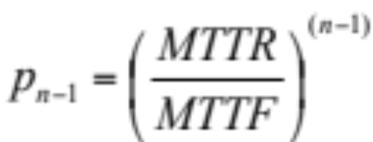
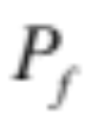
Fault Tolerance ...
N-plex repair- in this configuration the faulty equipment is repaired with an average time of MTTR (mean time to repair) as soon as a fault is detected. (Some times MTTR just time needed to replace)
Typical Values for recent disks:
  MTTR = Few hours (assuming we stock spare disks) to 1 Day
  MTTF = 750000 hours (~ 86 years)
Probability a particular module is not available
= MTTR/(MTTF+MTTR) ≅ MTTR/MTTF if MTTF >> MTTR
Probability of (n-1) modules unavailable =
Probability a module N fails = 1/MTTF

Slide 17
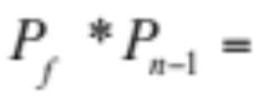
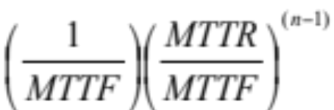
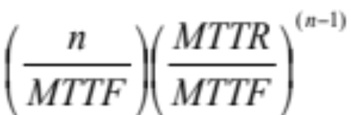
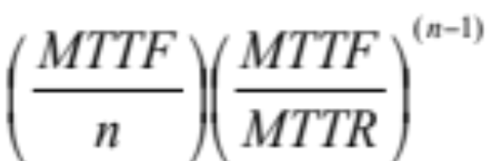
Fault Tolerance ...
Probability that the system fails with the particular i^{th} module failing last =
Probability that N-plex
system fails =
MTTF of N-plex system =

Slide 18
Fault Tolerance ...
E.g. MTTF 750000 hours and MTTR = 48-hours
  MTTF for a duplex system = 668,878 years
  MTTF for a triplex system = 6, 967,483,590 years
MTTF (days) | MTTR (days) | Number Devices | MTTF of the n-Plex System (days) | MTTF (years)
730 | 10 | 2 | 26645 | 73
730 | 10 | 3 | 1296723 | 3553
730 | 10 | 4 | 70995603 | 194509

Slide 19
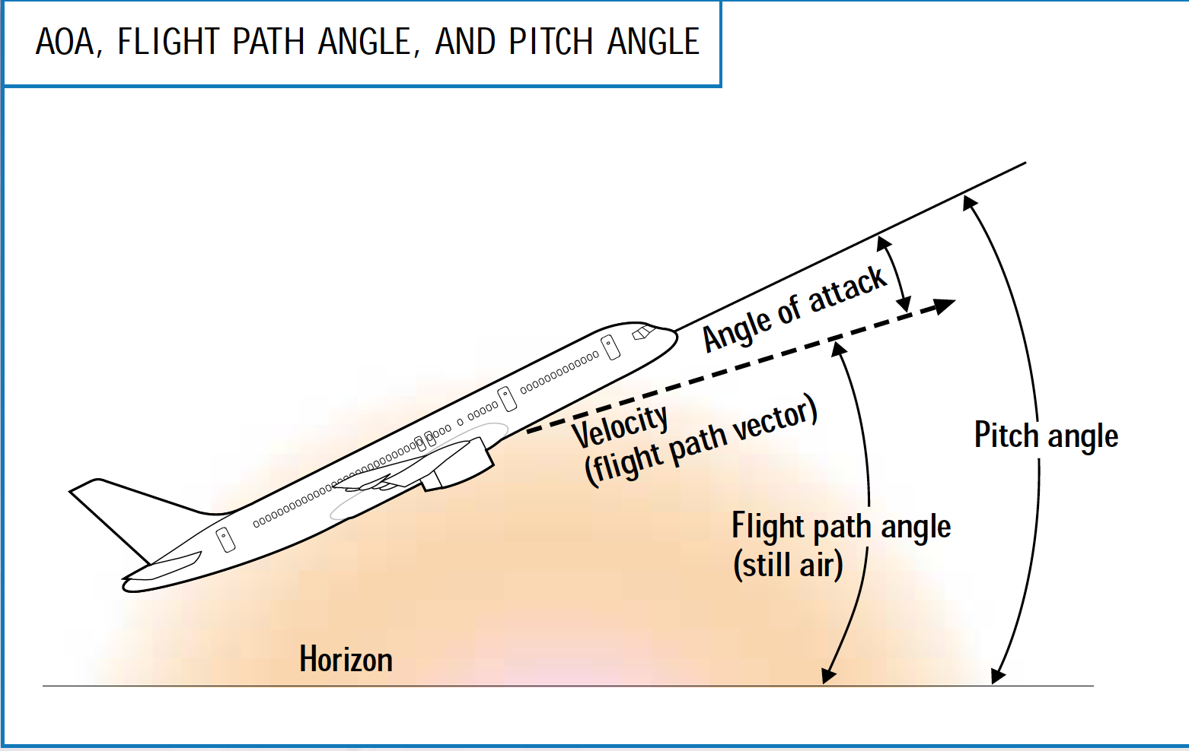
Boeing 737-8 MAX
There is senor to measure the attack angle. If it is too high the aircraft will lose lift and fall down like a brick. The rumor is Boeing 737-8 MAX did not build redundancy for measuring attack angle + software might have error that forced the plane to reduce the angle by pushing nose down and causing crash thinking the attack angle is too large!

Slide 20
Fault Tolerance ...
Old master - new master Technique
This method is very similar to shadow paging (we will discuss this later in detail).
  record all updates (transactions) to be performed in a separate file (stable store)
  at night (usually) produce a separate new (next day) master using the old (previous day’s) master and the batched updates (transactions).

Slide 21
Old Master and New Master
Old Master
Transactions
New Master

Slide 22
Fault Tolerance ...
This model of updates gives us fault tolerance because we can always produce new master file for the next day as long as we have old master file and the transactions to be performed.
The problem is -- this is not on line processing and the failure of a transaction is not notified to the client until the next day.

Slide 23
Software reliability
The main distinction between software reliability and hardware reliability:
  Hardware reliability requires tolerating component failures.
  Software reliability requires tolerating design and coding faults.
  The distinction between Hardware and Software is becoming less as most hardware units have substantial amount of software components. These systems are generally called embedded systems.
N-version programming
  use n programs which are run in parallel, taking majority vote for each answer
  the advantage is that the diversity of design and coding can mask many failures.

Slide 24
  Transactions
  Each program is written as an ACID state transaction with consistency checks.
  Restarting an application with out proper recovery (repair) can make the systems very unreliable.
  Even a transaction processing system cannot tolerate application errors.
  Bohrbugs (after the Physicist Niels Bohr) -- these are deterministic bugs – these are relatively easy to handle
  Heisenbugs (after the Physicist Werner Heisenberg) -- transient (non deterministic) software errors that only appear occasionally, these are usually related to load conditions and timing (race conditions).

Slide 25
Software reliability ...
Dense faults - these are the faults that a system can tolerate up to N faults with in a period. If there are more than N faults the system may be interrupted.
Byzantine faults - these are the faults which are not part of the model and the design is not catered to tolerate such faults. E.g. Designs that do not consider environmental issues like say earth quakes.

Slide 26
How to improve software reliability
Process Pairing
Periodic Transfer of data: One process called Primary does all the work until it fails. The second process called backup takes over the primary and continues the computation. In order to do this Primary need to tell on a regular basis that it is alive and also transmit its state to the secondary.
Checkpoint-restart: The primary records its state on a duplexed storage module. At takeover the secondary starts reading the state of the primary from the duplexed storage and resumes the application.

Slide 27
How to improve software reliability ...
Checkpoint messages: The primary sends its state changes as messages to the backup. At takeover the backup gets its current state from the most recent checkpoint message.
Persistent: backup restarts in the null state and lets Transaction mechanism to clean up all uncommitted transactions. This is the approach taken by the most Database Systems.

Slide 28
How to improve software reliability ...
Highly available storage
  write to several storage modules.
  have some kind of checksum to make sure that the data read is correct with a very high probability.
  Disk mirroring is an example of this.
  Shadowing is another mirroring technique which allows atomic write operations.
Highly available Processes
  process pairing
  transaction based restart
  checkpoint restart

Slide 29
How to improve communication reliability ...
Out = #messages sent
In= #messages received
Ack = #acknowledgements
In:6
Ack:3
Out:3
6:Out
6:Ack
3:In

Slide 30
How to improve communication reliability ...
Out = #messages sent
In= #messages received
Ack = #acknowledgements
In:6
Ack:3
Out:3
7:Out
6:Ack
3:In
7:msg

Slide 31
How to improve communication reliability ...
Out = #messages sent
In= #messages received
Ack = #acknowledgements
Reliable message passing
In:7
Ack:3
Out:3
7:Out
6:Ack
3:In
7:ack

Slide 32
How to improve communication reliability ...
Out = #messages sent
In= #messages received
Ack = #acknowledgements
Reliable message passing
In:7
Ack:3
Out:3
7:Out
7:Ack
3:In

Slide 33
How to improve communication reliability ...
Received message (In3);
Transmitted message(Out6);
Out:6 Ack:6 In:3
Received message (In6);
Transmitted message(Out3);
Out:3 Ack:3 In:6
Checkpoint before sending
a message
Stable storage for Node B
Stable storage for Node A
In:6
Ack:3
Out:3
6:Out
6:Ack
3:In

Slide 34
How to improve communication reliability ...
Received message (In3);
Record Transmitted message(Out7);
Out:7 Ack:6 In:3
Received message (In6);
Transmitted message(Out3);
Out:3 Ack:3 In:6
Stable storage for Node B
Stable storage for Node A
Checkpoint before sending
a message
In:6
Ack:3
Out:3
7:Out
6:Ack
3:In

Slide 35
How to improve communication reliability ...
Received message (In3);
Recorded Transmitted message(Out7);
Out:7 Ack:6 In:3
Received message (In6);
Transmitted message(Out3);
Out:3 Ack:3 In:6
Stable storage for Node B
Stable storage for Node A
Checkpoint before sending
a message
In:6
Ack:3
Out:3
7:Out
6:Ack
3:In
7:msg

Slide 36
How to improve communication reliability ...
Received message (In3);
Transmitted message(Out7);
Out:7 Ack:6 In:3
Received message (In7);
Transmitted message(Out3);
Out:3 Ack:3 In:7
Stable storage for Node B
Stable storage for Node A
Checkpoint before sending
a message
In:7
Ack:3
Out:3
7:Out
6:Ack
3:In

Slide 37
How to improve communication reliability ...
Received message (In3);
Transmitted message(Out7);
Out:7 Ack:6 In:3
Received message (In7);
Transmitted message(Out3);
Out:3 Ack:3 In:7
Stable storage for Node B
Stable storage for Node A
Checkpoint before sending
a message
In:7
Ack:3
Out:3
7:Out
6:Ack
3:In

Slide 38
How to improve communication reliability ...
Received message (In3);
Transmitted message(Out7);
Out:7 Ack:6 In:3
Received message (In7);
Transmitted message(Out3);
Out:3 Ack:3 In:7
Stable storage for Node B
Stable storage for Node A
Checkpoint before sending
a message
In:7
Ack:3
Out:3
7:Out
6:Ack
3:In
7:ack

Slide 39
How to improve communication reliability ...
Received message (In3);
Transmitted message(Out7);
Out:7 Ack:6 In:3
Received message (In7);
Transmitted message(Out3);
Out:3 Ack:3 In:7
Stable storage for Node B
Stable storage for Node A
Checkpoint before sending
a message
In:7
Ack:3
Out:3
7:Out
7:Ack
3:In

Slide 40
How to improve communication reliability ...
Received message (In3);
Transmitted message(Out7);
Out:7 Ack:6 In:3
Received message (In7);
Transmitted message(Out3);
Out:3 Ack:3 In:7
Stable storage for Node B
Stable storage for Node A
Checkpoint before sending
a message
In:7
Ack:3
Out:3
7:Out
7:Ack
3:In

Slide 41
How to improve communication reliability ...
Received message (In3);
Transmitted message(Out7);
Out:7 Ack:7 In:3
Received message (In7);
Transmitted message(Out3);
Out:3 Ack:3 In:7
Stable storage for Node B
Stable storage for Node A
Checkpoint before sending
a message
In:7
Ack:3
Out:3
7:Out
7:Ack
3:In

Slide 42
System Expectations
System Delusion (Wrong beliefs)
  Transaction system can guarantee correct behaviour with respect to reality.
  Application need not reflect reality.
Workflow systems are an extension of transaction systems whose behaviour can be expressed with rules/procedures to reflect the business process of a particular organization.
  E.g. A building permit should not be granted unless it is approved by various authorities such as EPI (Environment Protection Authority), National Trust, etc.
There is a nice example about inventory in Gray’s book.

Slide 43
Summary
Improving system’s reliability and hence its performance involves
Improving Hardware reliability that is CPUs, Memory and Storage Units. This can be done by employing lot of redundancy such as N-plex systems.
Software reliability can be improved by employing process-pairing or transaction based recovery.
Communication Systems reliability not only need hardware redundancy but also need to guaranty transmission and reception of messages and this can be done using stable storage and using the notion of retransmissions and repeated acknowledgements until messages are delivered and acknowledged.

